Slide 1
Money & it’s Functions

Slide 2
Money
Money is any object or item which is generally accepted as a mode for payment of goods & services and repayment of loans or debts, such as taxes, etc., in a particular nation or country. Money was invented to facilitate trade as the barter system was not able to express the value and prices of goods & services. The term money covers all things like currency notes, coins, cheques, etc., to carry out all economic transactions and settle claims. As a currency, money circulates from country to country and person to person to facilitate trade. Different stages of money are Commodity Money, Metallic Money, Paper Money, Credit Money and Plastic Money.

Slide 3
Functions of Money
The functions of money can be divided into two categories, i.e., Primary Functions and Secondary Functions. The Primary Functions are the main or basic functions of money; whereas, the Secondary Functions are the subsidiary or derivative functions of money.

Slide 4
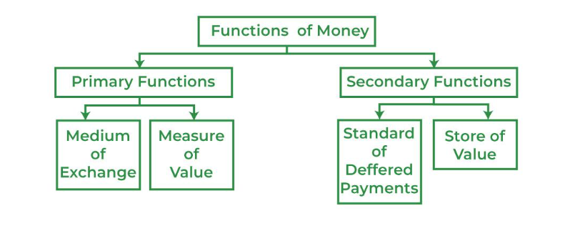

Slide 5
Primary Functions
Primary functions consist of the most important functions performed by money in every country. These functions are:
1. Medium of Exchange
As a medium of exchange, money can be used to make payments to all the transactions related to goods & services. It is the most important function of money. As money is universally accepted, therefore all exchanges take place in terms of money.
This function of money eliminates the major problem of double coincidence of wants and the problems related to the barter system.
This function of money facilitates the trade in an economy and allows purchase and sale to be conducted independently of each other.
Money itself does not have the power to satisfy human wants. However, it commands the power to buy goods and services wanted and required by human beings, which can in return satisfy their wants.

Slide 6
2. Measure of Value
As a measure of value money works as a common parameter, in which the value of every good & service is expressed in monetary terms.
This function of money helps in maintaining the business accounts, which would be impossible otherwise.
It helps in determining the relative prices of goods & services due to this, it is also known as a Unit of Account. For example, In India, Rupees is the unit of account, in America, it is Dollar, etc.
By limiting the value of all goods & services to a single unit, it becomes very easy to find out the exchange ratio between them and to compare their prices.
For example, the value of every product is estimated in monetary terms. The value of 1 egg is estimated at ₹ 6 in India, and the value of a packet of bread is around ₹ 45. So, money works as a measure of the value of all goods & services and is the amount that is required to be received or paid during the transaction. Therefore, it is one of the most essential functions of money.

Slide 7
Secondary Functions
Secondary functions are supplementary to primary functions and are derived from primary functions; therefore, they are also known as Derivative Functions.
1. Standard of Deferred Payments
The Standard of deferred payments states that money act as a "standard of payment", which is to make in the present or in near future. On a daily basis, millions of transactions are made in which payments are not made immediately. Money encourages such transactions and facilitates capital formation & economic development of the nation. This function of money is important because:
It leads to the creation of financial institutions.
It simplifies the borrowing and lending operations.
For example, if someone borrows a certain amount from another person, they need to repay the amount to that person with interest. With money as standard payment, it is easy to pay the interest or make deferred payments. This has led to an increase in lending and borrowing transactions and has contributed to the formation of financial institutions.

Slide 8
2. Store of Value or Asset Function of Money
Money as a store value can be used to store wealth in the most economical and convenient way and to transfer the purchasing power from the present to the future.
Money as a store value has the following advantages:
It was very difficult to store wealth in terms of goods because of their perishable nature and high cost. Money provides a solution to this problem as one can store money for as long as possible.
Money has the quality of universal acceptability. Therefore, one can at any time use money in exchange for goods and services.
Money is easily portable, and saving money is much easier and more secure than saving goods for future use.

Slide 9
Money has overcome the Drawbacks of the Barter System
Barter system refers to the exchange of goods & services with two or more parties without the use of money. In this system, the exchange of goods & services was very difficult. Money makes the exchange easy and overcomes the drawbacks of the barter system in the following ways:
1. Medium of Exchange
As a medium of exchange, money eliminates the major problem of lack of double coincidence of wants of barter system. It allows both sale and purchase activity to act independently, which leads to increased satisfaction for both the parties involved. It means that a buyer can purchase goods through money; similarly, a seller can sell goods and can get money in return.
2. Measure of Value
Under the barter system, different goods of different values were exchanged, as there was no single unit of measurement or denomination to express their value. As a measure of value, money provides a common parameter to express the value of all goods & services in monetary terms, which makes it easy to compare the relative value of two commodities.
3. Standard for Deferred Payments
In the barter system, there is no appropriate standard of deferred payments, which makes credit transactions difficult to execute, as the borrower may not be able to arrange the same quality goods at the time of repayment. Money solves this problem by providing an appropriate standard for deferred payments. This has led to an increase in lending and borrowing transactions and has contributed to the formation of financial institutions.
4. Store of Value
In a barter system, it was very difficult to store wealth in form of goods, as most of the goods were of perishable nature and required huge space and heavy transportation costs. Money makes it easy to store wealth in the most convenient, secure, and economical way to meet contingencies and unpredictable emergencies.

